Slide 1
Module 2
Introduction to HTML/XHTML

Slide 2
Basic Text Markup
Paragraphs
Text is placed in the content of a paragraph element
Specified with the tag <p> </p>
The browser puts as many words as will fit on the line in the browser window.
Browser supplies a line break at the end of each line
html\paragraph.html
<p> tag appears at a position other than the beginning of the line- browser breaks the current line and inserts a blank line.
html\paragraph_2.html

Slide 3
Line breaks
Explicit line break without the preceding blank line.
Break tag- <br />
In HTML break tag can be written as <br>
html\Linebreak.html

Slide 4
Preserving White Space
To preserve the white space in text.
To prevent the browser from eliminating multiple spaces and ignoring embedded line breaks.
Specified with the pre tag- <pre> </pre>
pre element not only keeps line breaks from the source, it also preserves the character and line spacing.
Can contain virtually any other tags, except those that cause a paragraph break.
Should avoid special characters such as <.
html\preserve.html

Slide 5
Heading
Text in a document is divided into different sections.
Each sections begin with a heading
HTML –six levels of headings
<h1>,<h2>,<h3>,<h4>,<h5> and <h6>
Headings are usually displayed in a boldface font whose default font size depends on the number in the heading tag.
<h1> -highest level heading

Slide 6
<h1>,<h2> and <h3> - font size larger than the default size of the text
<h4> - uses the default size
<h5> and <h6> - use smaller sizes.
Heading tag always break the current line-content appears in the new line.
Browser usually insert some vertical space before and after all headings.
html\Headings.html

Slide 7
Block Quotations
Block of text to be set off from the normal flow of text in a document.
In many cases, such a block is a long quotation
<blockquote> tag is used.
Browser designers are allowed to determine how the content should appear.
Most cases the block of text is indented on the both sides.
html\Block_quotations.html

Slide 8
Font style and size
content-based style tags- they indicates the particular kind of text that appears in their content.
Three of the most commonly used content-based tags are
emphasis tag- <em> - content is special and should be displayed in some way that indicates this distinctiveness - Most browsers use italics
strong tag- <strong> - Browsers often set the content of strong elements in bold
code tag- <code> - is used to specify a monospace font, usually for program code.
html\font.html

Slide 9
Character Entities
special characters are defined as entities, which are codes for the characters.
An entity in a document is replaced by its associated character by the browser

Slide 10
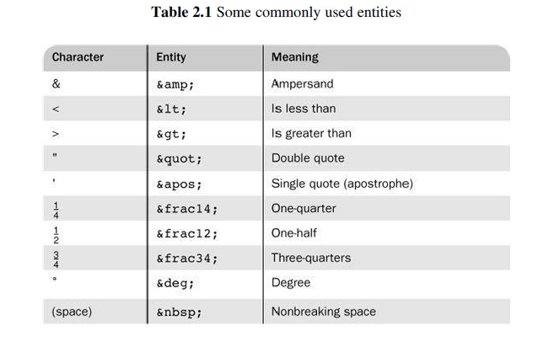
html\character entities.html

Slide 11
Horizontal Rules
The parts of a document can be separated from each other, by placing horizontal lines between them.
<hr />
The <hr /> tag causes a line break (ending the current line) and places a line across the screen.
The browser chooses the thickness, length, and horizontal placement of the line.
Typically, browsers display lines that are three pixels thick.
html\horizontal rule.html

Slide 12

The meta Element
to provide additional information about a document, primarily for search engines.
two attributes that are used to provide information are name and content.
Example 1:
<meta name = “keywords” content = “binary trees,
linked lists, stacks” />
Example 2:

Slide 13
IMAGES
To display an image the image tag <img/> is used in XHTML
The image tag includes two attributes src and alt
The src specifies the file containing the image
The alt specifies the text that should be displayed when it is not possible to display the image
eg. Internet connection is slow
<img src="images/HennesseyVenom.jpg“
alt=“Image of the fastest car in the World" />

Slide 14
Two optional attributes of img, width and height can be included to specify the size of the image
eg. <img src="images/ritchie.jpg" width="100" height="150" alt="Photo of Dennis M Ritchie" />
IMAGE1.html

Slide 15
HYPERTEXT LINKS
The Hypertext link acts as a pointer to some resource
Links are used to connect between logically related documents
The Link specifies the address of the other document
Links are specified in an attribute of an anchor tag (<a></a>)
The anchor tag that specifies a link is called the source of the link
The document whose address is specified in a link is called the target of the link
The anchor tag has an attribute called hypertext reference (href) which specifies the target of the link

Slide 16
If the target document is in the same directory the target is just the documents filename
If the target document is in some other directory the pathname also should be supplied
Links are rendered in a different color than the surrounding text and also underlined
eg. <a href="Sample10.xhtml">To see the image of Zukoi click here</a>
Image itself can be used as a link so that when the image is clicked it will connect the execution to a new document
LINK.html

Slide 17
The following example shows where a image itself is used as a link to another image
<a href="antonov.jpg">
<img src = "small-antonov.jpg“
alt = "The image of the largest aeroplane" />
</a>
The links helps to create a table of contents that provide users to get to the various parts of a document simply and quickly
LINK 2.html

Slide 18
Targets within Documents
The target of a link can be some element within a document, at the starting or middle part or at the end of a document
The target element can include an id attribute which can then be used to identify it in a href attribute
<h2 id ="avionics">Avionics</h2>
If the target is with in the same document as the link then the target is specified in the href attribute value by preceeding the id value with a pound sign(#) as shown in the following example
<a href = "#avionics">What about avionics?</a>

Slide 19
If the target is a part of another document then the name of the part is specified at the end of the URL seperated by a pound sign (#) as shown in the following example
<a href = “Sample2.xhtml#avionics“>Avionics</a>
LINK 3.html

Slide 20
LISTS
XTML has simple and effective ways to represent lists in documents
Lists can of three types
unordered lists
ordered lists
definition lists

Slide 21
Unordered Lists
The unordered list <ul> tag is a block tag that creates an unordered list
All entries in an unordered list must be enclosed within <ul> …</ul>
Each item in a list is specified with a list item <li> tag
In the display each list item is implicitly preceded with a bullet

Slide 22
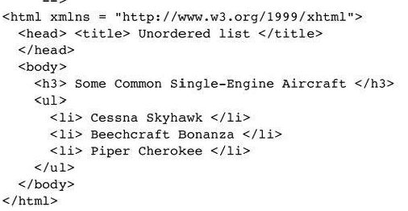
Sample code

Slide 23
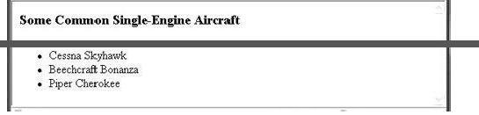
Output

Slide 24
Ordered Lists
An ordered list element can be defined with the tags <ol>…</ol>
Every item in an ordered list begins with a sequence number
Ordered list by default uses decimal sequence numbers
To change the sequence type use attribute type in the <ol> opening tag
The attribute type can have different values like 1, I, i, A, a etc.
1 is used for decimal numbers
I for uppercase roman number sequence
i for lowercase roman number sequence
A for uppercase alphabetic sequence
a for lowercase alphabetic sequence

Slide 25
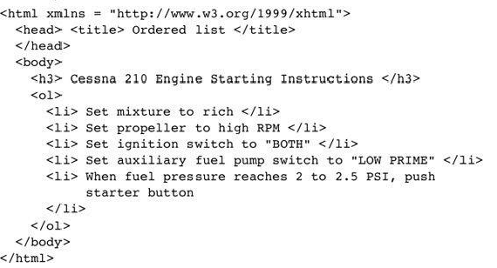
Sample code

Slide 26
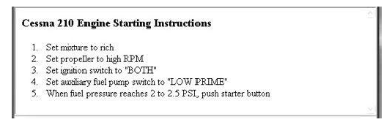
output

Slide 27
Definition Lists
The definition lists are used to specify lists of terms and their definitions
A definition list is given as the content of a <dl> tag which is a block tag
Each term to be defined in the definition list is given as the content of a <dt> tag
The definition themselves are specified as the content of <dd> tags
The defined terms of a definition list are displayed on the left margin and definitions are shown on the next line which are indented

Slide 28
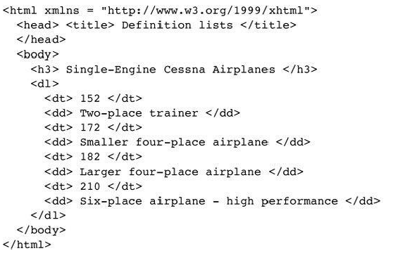
Sample code

Slide 29
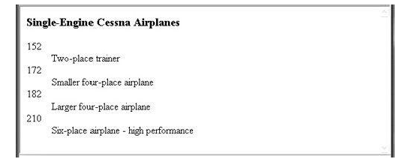
Output

Slide 30
TABLES
A table is a matrix of rows and columns in which each intersection of a row and a column is called a cell.
A table is specified by the block tag <table>
There is a border attribute for the table tag which specifies the width of the border and can have values from 0 onwards
A border value of 0 specifies no border and a border value greater than 3 gives a three-dimensional appearance for the table
The table title is given as a content of the <caption> tag

Slide 31
The opening <table> tag
The cells of a table are specified one row at a time with a row tag <tr> <tr/>
The row heading or also called labels is specified with the <th> <th/>tag
Each data cell of a row is specified with the table data tag <td> <td/>
Table.html

Slide 32
Multiple cells in a table can be joined row wise and column wise using the rowspan and colspan attribute
The align attribute is used for the horizontal placement of the content within a cell
The align attribute can have values left, right and center
colspan.html
<td rowspan="3" valign = "bottom">Item 1</td>
<td colspan="5" align = "center">Item 12</td>

Slide 33
The valign attribute is used for the vertical placement of the content within a cell
The valign attribute can have values top, bottom and center
The cellpadding attribute is used to specify the spacing between the content of a cell and the inner walls of the cell
The cellspacing attribute is used to specify the distance between the cells in a table
table eg.html

Slide 34
Forms
Forms are used to collect information from the user and communicate to the server
Forms are filled out by the user
XHTML provides tags to generate the commonly used objects on a form
The objects of a form are called controls or widgets or components.
The commonly used controls are text box, check box, radio button, drop down menu etc.

Slide 35
All control tags are inline tags.
Every form requires a Submit button
when the user clicks the submit button the form data is encoded and sent to the Web server for processing.

Slide 36
All the components of a form appear in the content of a <form> block tag
The <form> has a method attribute that has two values get or post.
The default is get method.

Slide 37
input Element
The most commonly used tag in a form is the <input> tag that is used for text, passwords, checkboxes ,radio buttons, reset and submit controls
Attributes-
type – particular kind of control required.
name – used by the server to find the specific component value in the form data.
Value-initializes the value of the control.

Slide 38
Text control
If the type attribute is text a horizontal box is created into which the user can type a line of text
<body>
<form>
<p>
<label>First name:
<input type="text" name="firstname">
<label/>
<br>
<label>Last name:
<input type="text" name="lastname">
<label/>
<p/>
</form>
</body>
form.html

Slide 39
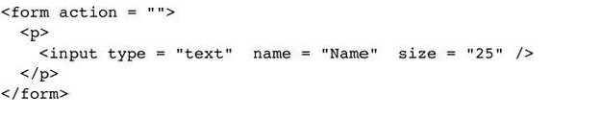
Size attribute- Size of text box.
If the user types more characters than will fit in the box, the box is scrolled.
Default size of text box is 20 characters.

Slide 40
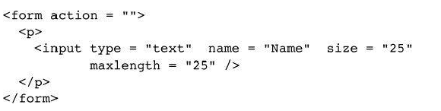
maxlength attribute- specify the maximum number of characters that the browser will accept in the box.
Additional characters are ignored.

Slide 41

Password control
If the type attribute is password the contents of text box will not be displayed
only bullets or asterisks are displayed instead of characters
form.html

Slide 42
Checkbox control
If the type attribute is checkbox then a list of items can be checked
The checkbox button has a name attribute and a value attribute
Name identifies the button and the value is its value.
In the checkbox list every one in the list must have the same name.
In checkbox more than one value can be selected at a time.
The attribute checked, which is assigned the value checked, specifies that the checkbox button is initially on.

Slide 43
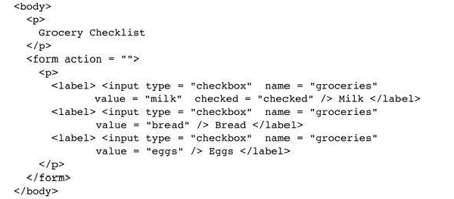
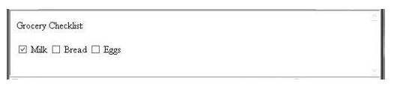

Slide 44
Radio button
If the type attribute is radio then only one radio button can be on or pressed at any time
All radio buttons in a group must have the name attribute same
form.html

Slide 45
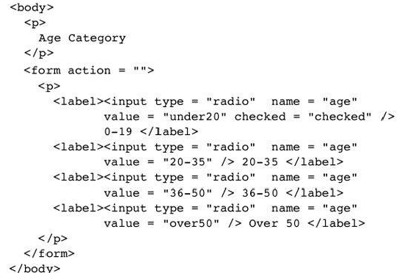
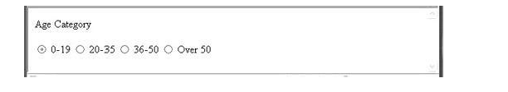

Slide 46
Select element
If the number of possible choices is large a <select> tag can be used.
The <select> tag produces a drop down menu for selection and each item in the menu is specified with an <option> tag .
Attributes-
Multiple – multiple menu can be selected at a time. Value is “multiple”
Size- number of menu that initially are to be displayed for the user.

Slide 47
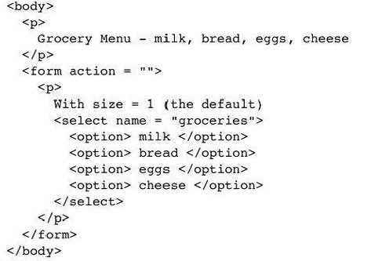
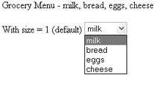


Slide 48
text area element
In certain cases multiple lines of text should be accepted by the form and for this a <textarea> tag can be used
Rows and columns attribute can be used to fix the size of <textarea>
There is implicit scrolling when needed, both vertically and horizontally
If some default text is to be included in the text area, it can be included as the content of the text area element.

Slide 49
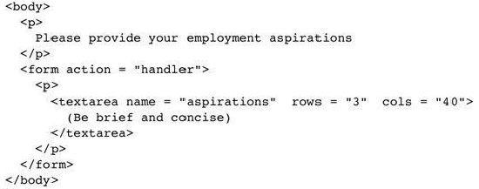
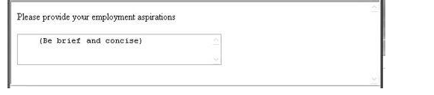

Slide 50
Action buttons
The Reset button clears all of the controls in the form to their initial states
The submit button encodes the data in the form and sent to the server
Every form requires a Submit button
The Submit and Reset buttons are created with the <input> tag

Slide 51
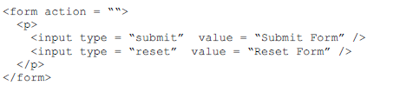


Slide 52
example
Fig.pdf

Slide 53
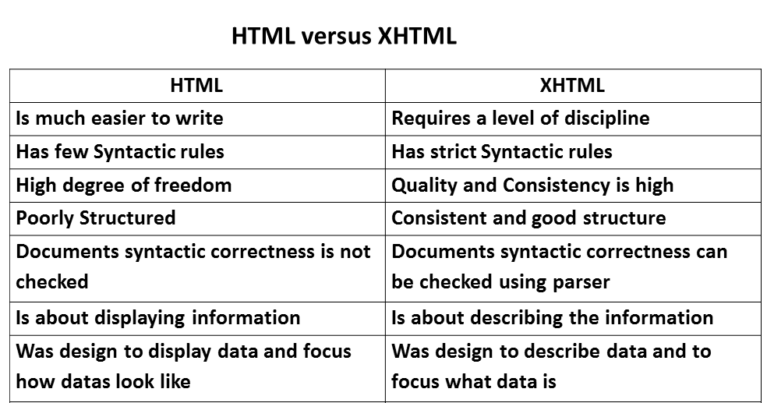

Slide 54
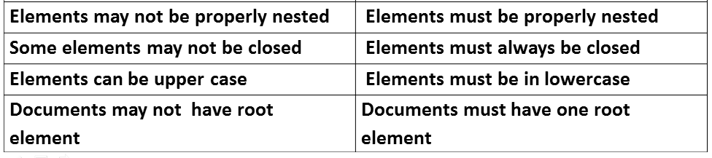

Slide 55
HTML5
The audio Element
<audio> </audio> tag is used.
Audio information is coded into digital streams with encoding algorithms called audio codecs.
An audio codec is a computer program implementing an algorithm that compresses and decompresses digital audio data according to a given audio file.
Most commonly used audio codecs are:
MPEG-3(MP3)
Vorbis
Wav

Slide 56
Coded audio data is packed in containers.
Audio containers are:
Ogg
MP3
Wav
Type of container is indicated by the extension on the file’s name.
Vorbis codec audio is stored in Ogg containers.
MP3 codec audio is stored in MP3 containers.
Wav codec audio is stored in Wav containers.

Slide 57
control attribute
Commonly used attribute of the audio element is controls. Always set to “controls”
Creates a display of a start/stop button, a clock, a slider of the progress of the play, the total time of the file and a slider for the volume control.

Slide 58
The general syntax of an audio element:
<audio attributes>
<source src = “filename1”>
.
.
<source src = “filenamen”>
your browser does not support the audio element
</audio>
www.w3schools.com/html/tryit.asp?filename=tryhtml5_audio_all

Slide 59
The video Element
<video> </video> tag is used.
Video information is digitized into data files using algorithms called video codecs.
Video containers used are:
MPEG-4(.mp4 files)
Flash video (.flv files)
Ogg (.ogv files)
WebM (.webm files)
Audio Video Interleave (.avi files)

Slide 60
Most commonly used video codecs are:
MPEG-4AVC / MP4
Theora / any container
VP8 / WebM
Commonly used container/video codec/audio codec combination are
Ogg/ Theroa/Vorbis
MP4/H.264/AAC
WebM/VP8/Vorbis

Slide 61
General syntax of a video element:
<video attributes>
<source src = “filename1”>
.
.
<source src = “filenamen”>
your browser doesnot support the video element
</video>

Slide 62
Video Attributes:
width and height- set the size of the screen for the video in pixels.
autoplay- video plays automatically as soon as it is ready
Preload- load the video file as soon as the document is loaded.
Control-specifies that play, pause and volume control be included in the display
Loop- specifies that the video is to be played continuously.
https://www.w3schools.com/html/tryit.asp?filename=tryhtml5_video

Slide 63
THANK YOU

